Slide 1

Maximum & Minimum Applied Electronics Example 3
RCET 0264 Introductory Calculus
Tim Leishman

Slide 2

Maximum & Minimum
Find the greatest current in an 8-microfarad capacitor if the applied voltage is $v =250t^{2}−200t^{3}$

Slide 3


Maximum & Minimum
Find the greatest current in an 8-microfarad capacitor if the applied voltage is $v =250t^{2}−200t^{3}$
$$Ic=C\frac{dv}{dt}$$
$$v =250t^{2}−200t^{3}$$
$\frac{dv}{dt}=500t −600t^{2}$
$0=500t −600t^{2}$
$−600t^{2}+500t+0=0$
$t=0 or 833.333mS$
$t=833.333mS$

Slide 4
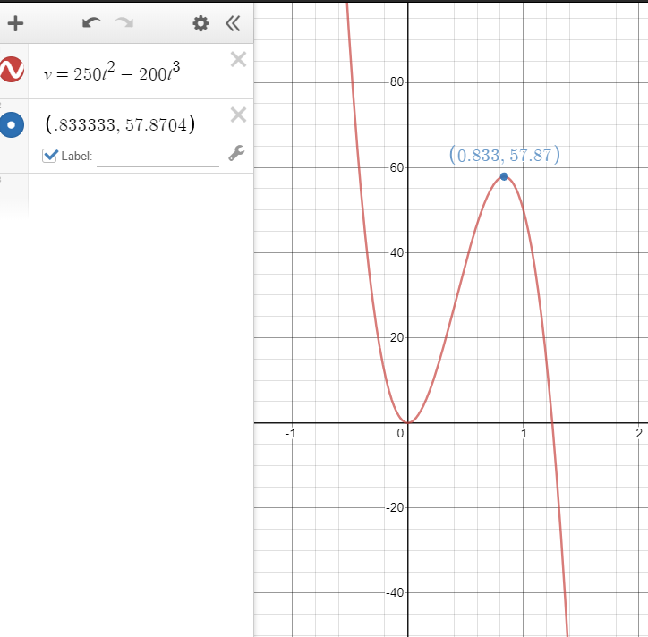

Maximum & Minimum
Find the greatest current in an 8-microfarad capacitor if the applied voltage is $v =250t^{2}−200t^{3}$
$$Ic=C\frac{dv}{dt}$$
$$v =250t^{2}−200t^{3}$$
$$t=833.333mS$$
$v =250{(833.333mS)}^{2}−200{(833.333mS)}^{3}$
$v=173.611v −115.741v$
$v=57.8704v$

Slide 5

Maximum & Minimum
Find the greatest current in an 8-microfarad capacitor if the applied voltage is $v =250t^{2}−200t^{3}$
$v =250t^{2}−200t^{3}$
$$\frac{dv}{dt}=500t −600t^{2}$$
$$t=833.333mS$$
$Ic=C\frac{dv}{dt}$
$Ic=8uF(500t −600t^{2})$
$Ic=8uF(500(833.333mS) −600({833.333mS}^{2})$
$Ic=8uF(416.667 −416.666)$
$Ic=8uF(0)$
$Ic≈0 at time 833.333mS$

Slide 6

Maximum & Minimum
Find the greatest current in an 8-microfarad capacitor if the applied voltage is $v =250t^{2}−200t^{3}$
$v =250t^{2}−200t^{3}$
$$\frac{dv}{dt}=500t −600t^{2}$$
$Ic=C\frac{dv}{dt}$
$Ic=8uF\left(500t −600t^{2}\right)$
$IC= .004t−.0048t^{2}$
$\frac{di}{dt}=.004−.0096t$
$0=.004−.0096t$
$t=\frac{.004}{.0096}$
$t=416.667ms$

Slide 7
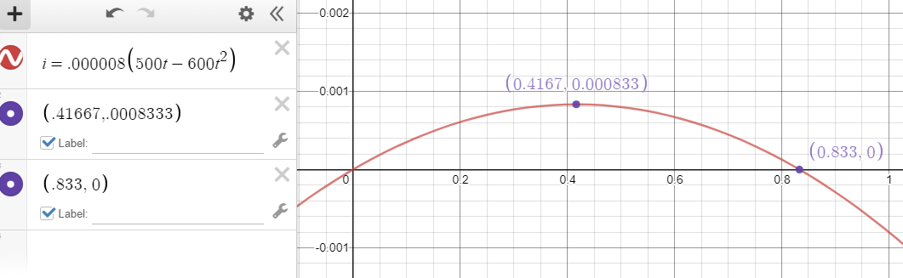


Maximum & Minimum
Find the greatest current in an 8-microfarad capacitor if the applied voltage is $v =250t^{2}−200t^{3}$
$v =250t^{2}−200t^{3}$
$$\frac{dv}{dt}=500t −600t^{2}$$
$Ic=C\frac{dv}{dt}$
$Ic=8uF\left(500t −600t^{2}\right)$
$IC= .004t−.0048t^{2}$
$$t=416.667ms$$
$IC= .004(416.667mS)−.0048{(416.667mS)}^{2}$
$IC= 1.667mA −.8333mA$
$IC=833.333uA$

Slide 8
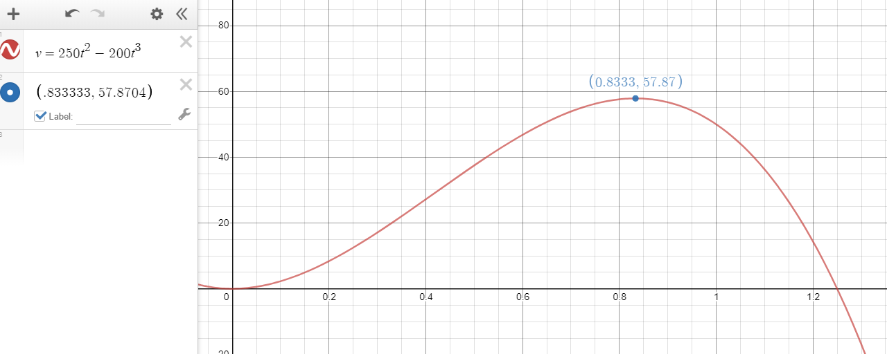

Maximum & Minimum
Find the greatest current in an 8-microfarad capacitor if the applied voltage is $v =250t^{2}−200t^{3}$
$$t=833.333mS$$
$v=57.8704v$
$$t=416.667ms$$
$IC=833.333uA$

Slide 9
Maximum & Minimum
References:
Ewen, D., Gary, J. S., & Trefzger, J. E. (2005). Technical calculus. Upper Saddle River, NJ: Pearson/Prentice Hall.
Richmond, A. E., & Hecht, G. W. (1995). Calculus for electronics. New York: Glence.
https://www.desmos.com
https://www.autodesk.com/products/fusion-360/overview

